Slide 1

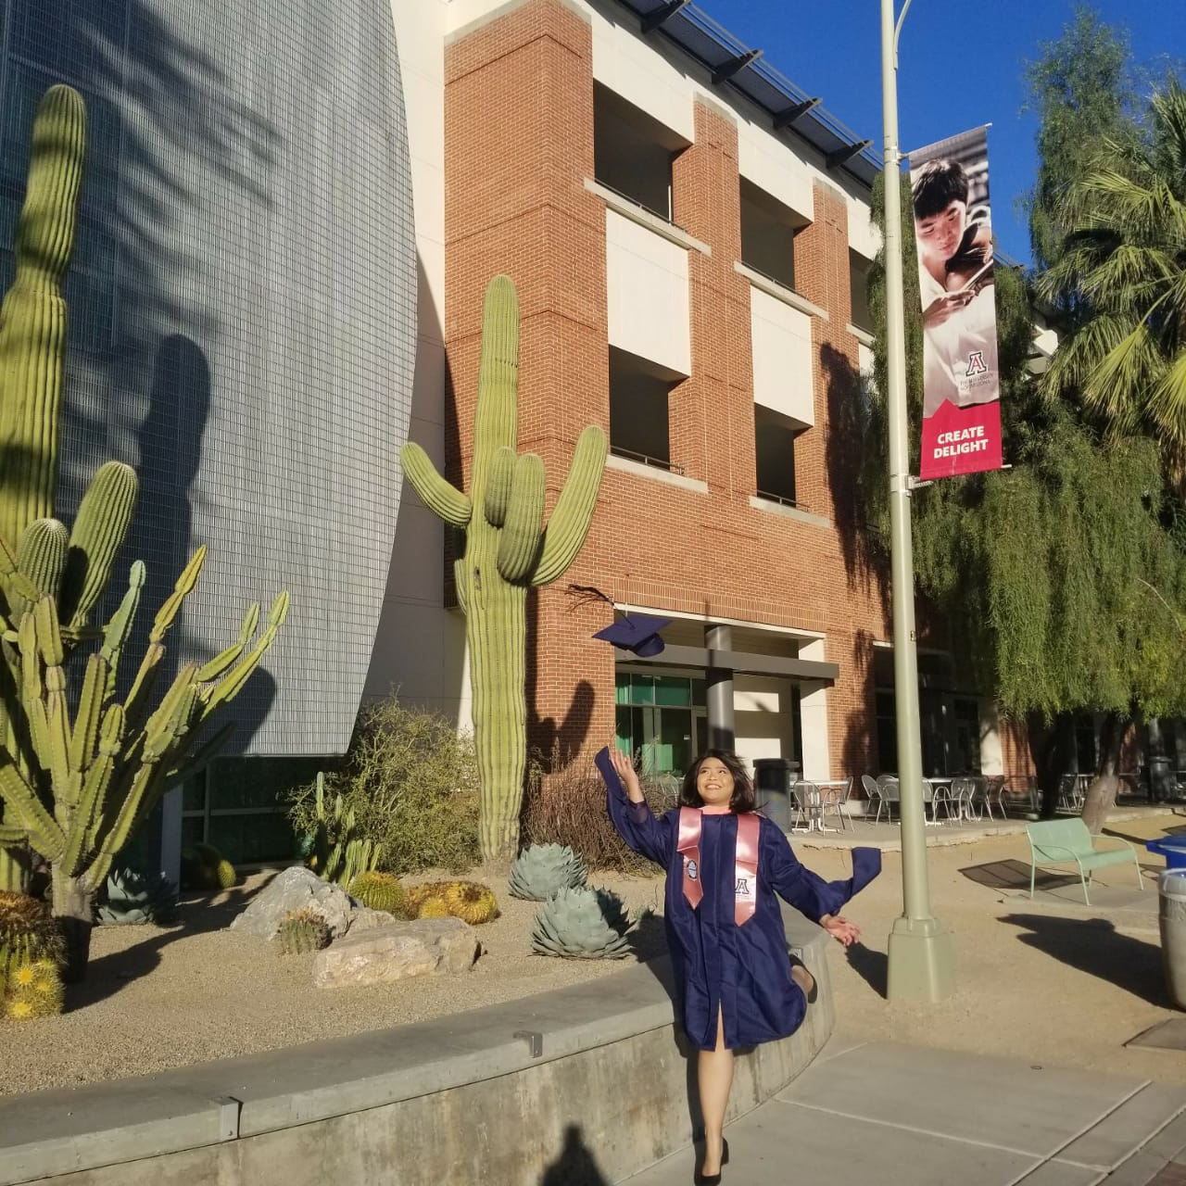


Experiences
on Studying Abroad
Studying abroad is a transformative experience of new cultures, expanding worldview, and enhancing our personal and professional development.
Komang Triyani Kartinawati, MD, MPH

Slide 2

Reasons for Pursuing
a Study Abroad
1
Cultural Competency
2
Global Perspective
Studying abroad fosters cultural awareness and the ability to work with multicultural perspectives
Students gain a broader understanding of issues on an international scale.
3
Networking
4
Personal Growth
Collaborating with local professionals opens doors for future partnerships and career opportunities.
Adapting to new environments and tackling challenges builds resilience and independence.

Slide 3

Preparing for the Study Abroad
Language Proficiency
Cultural Research
Developing English proficiency is one of requirements to apply for studying abroad and scholarship.
Familiarizing yourself with the local customs, norms, and etiquette to make you easily adapt with the community and respect the culture.
Adjustment
Settlement
Considering the climate, cultural dress, and necessary medications or supplies can help ensure a smooth and comfortable stay.
Arranging for housing, transportation, and healthcare as your basic needs of staying faraway from home.

Slide 4
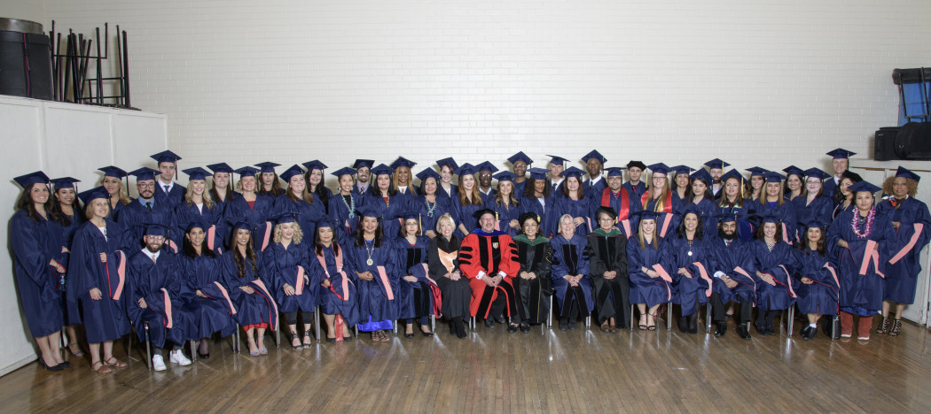




Finding Scholarship Programs
University Scholarships
Government Funding
Nonprofit Organizations
Study Abroad Providers
Many universities offer scholarships specifically for study abroad programs.
LPDP, BPI, or other scholarships from Ministry in Republic of Indonesia
Fulbright, AAS, The Gates Scholarship, USAID, etc
IDP, Education First (EF), Edlink International, International Education Center, etc

Slide 5
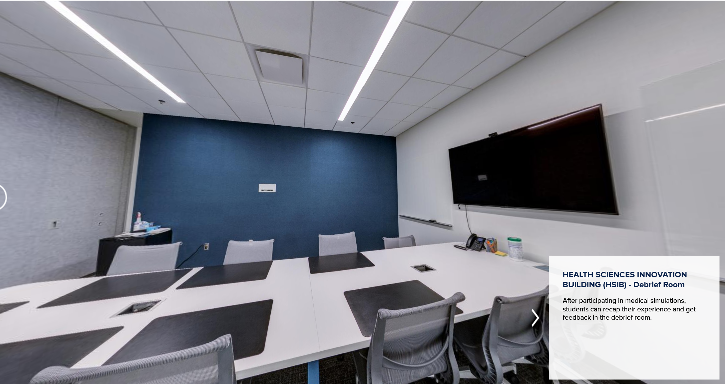
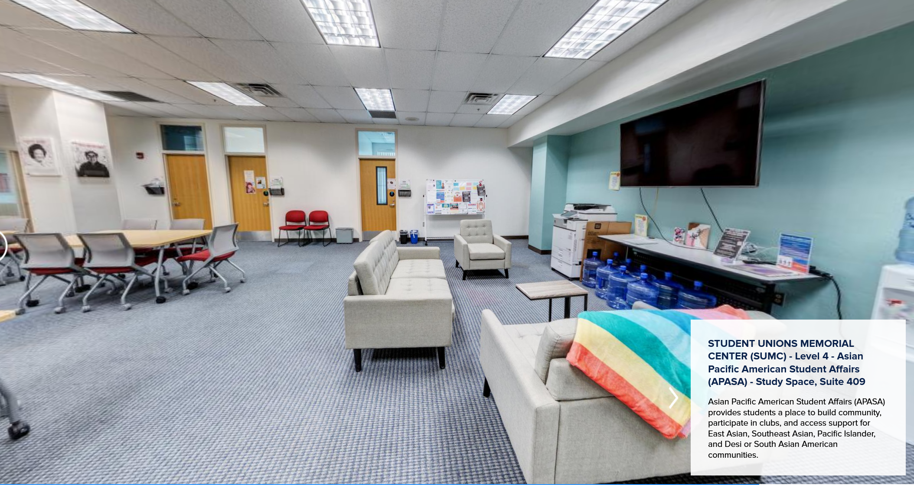
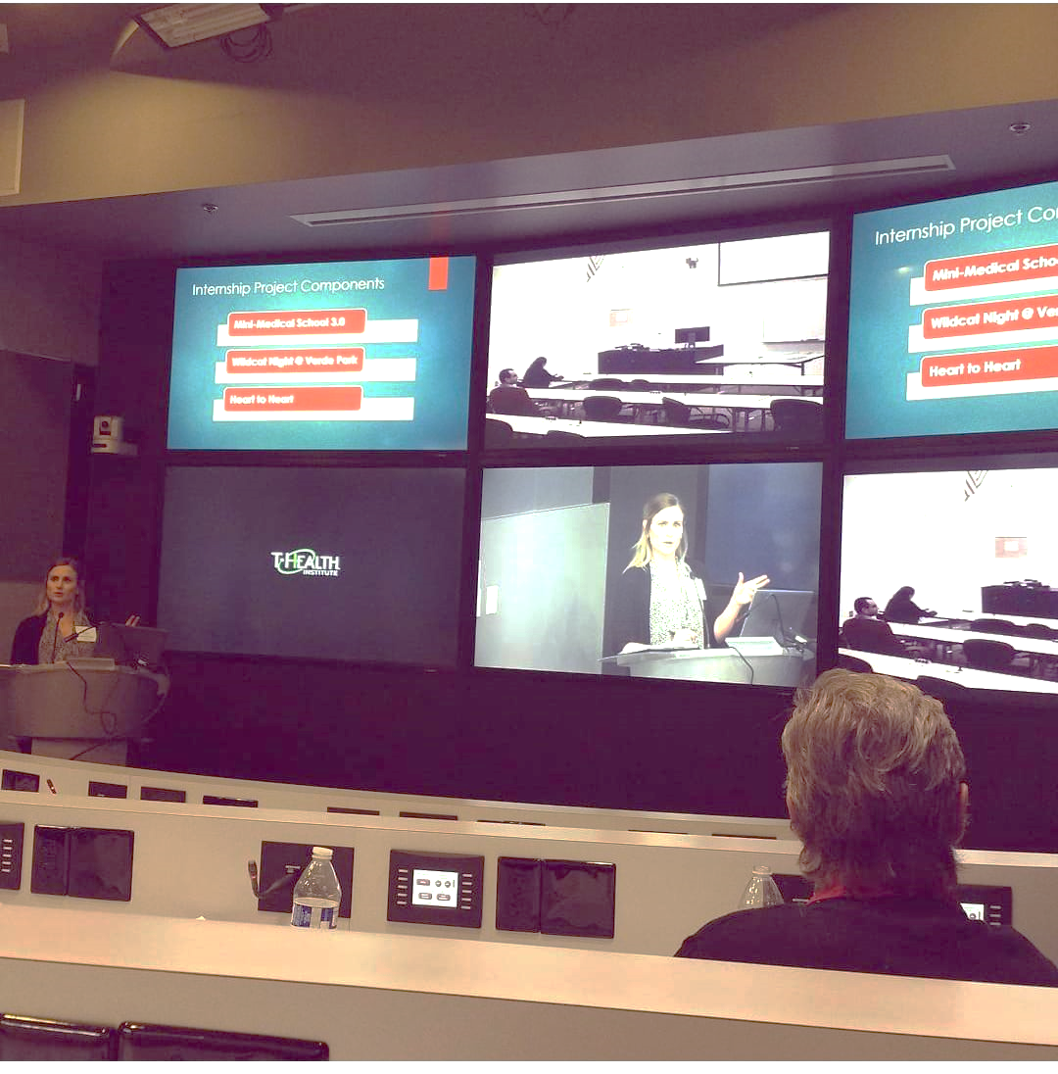
Academic Culture
Classroom Dynamics
The classroom environment features more interactive discussions, hands-on activities, and a stronger emphasis on practical applications.
Teaching Styles
Professors often employ a range of innovative teaching methods, such as case studies, site visits, and guest lectures, to enhance the learning experience.
Collaborative Learning
Students are encouraged to work closely with their peers, sharing diverse perspectives and learning from one another.

Slide 6
COMMUNITY OUTREACH

Slide 7
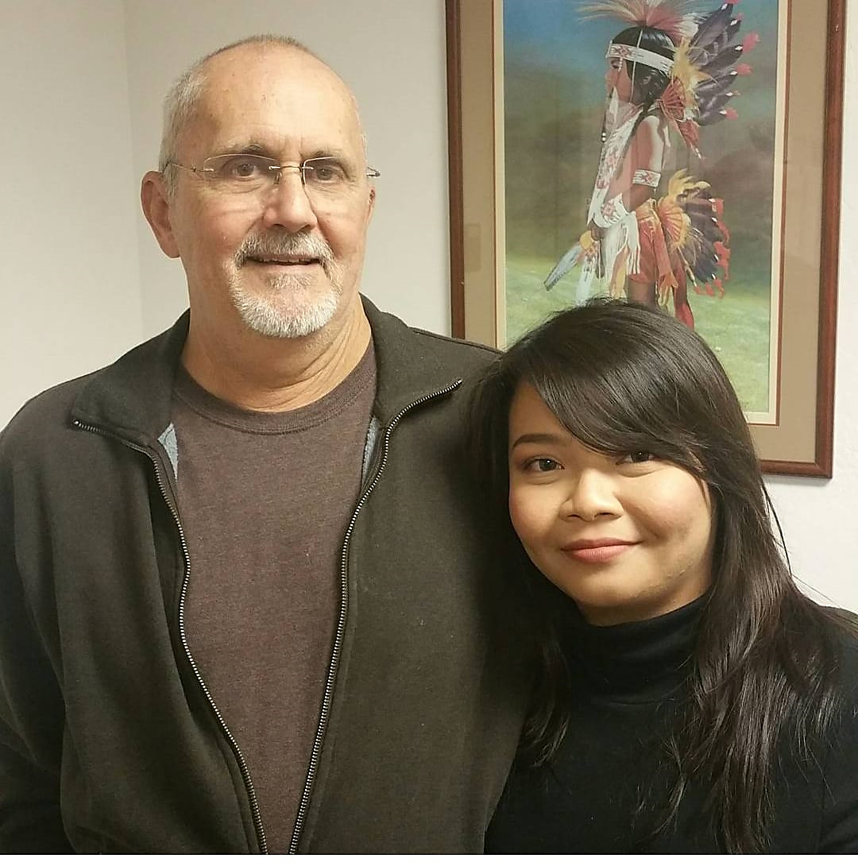


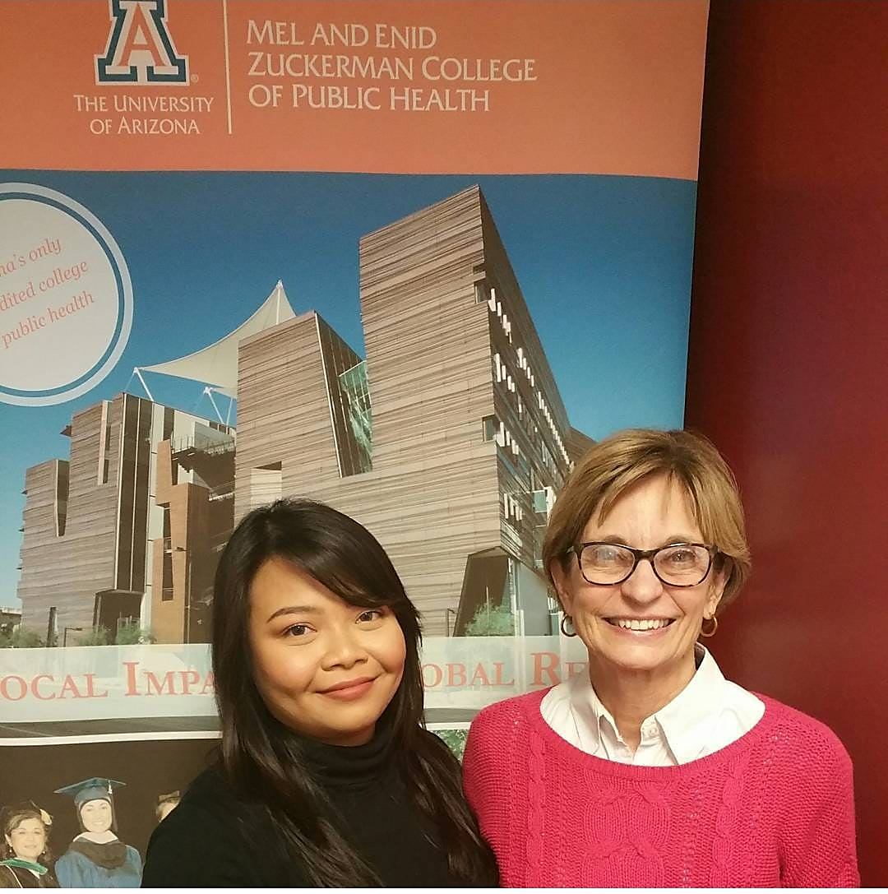


Lecture - Student Interaction
Active Participation
Collaborative Learning
Students are encouraged to engage actively in lectures, contributing their thoughts and experiences to discussions.
Professors foster a dynamic learning environment, facilitating discussions and encouraging peer-to-peer learning.
Global Perspective
Office Hours
Lectures often incorporate diverse case studies and guest speakers (CDC, DHHS, USPHS) to provide a comprehensive and international view.
Professors provide “office hours’’ for student to discuss lectures, assignment, or project. Students can also choose to interact through emails.

Slide 8
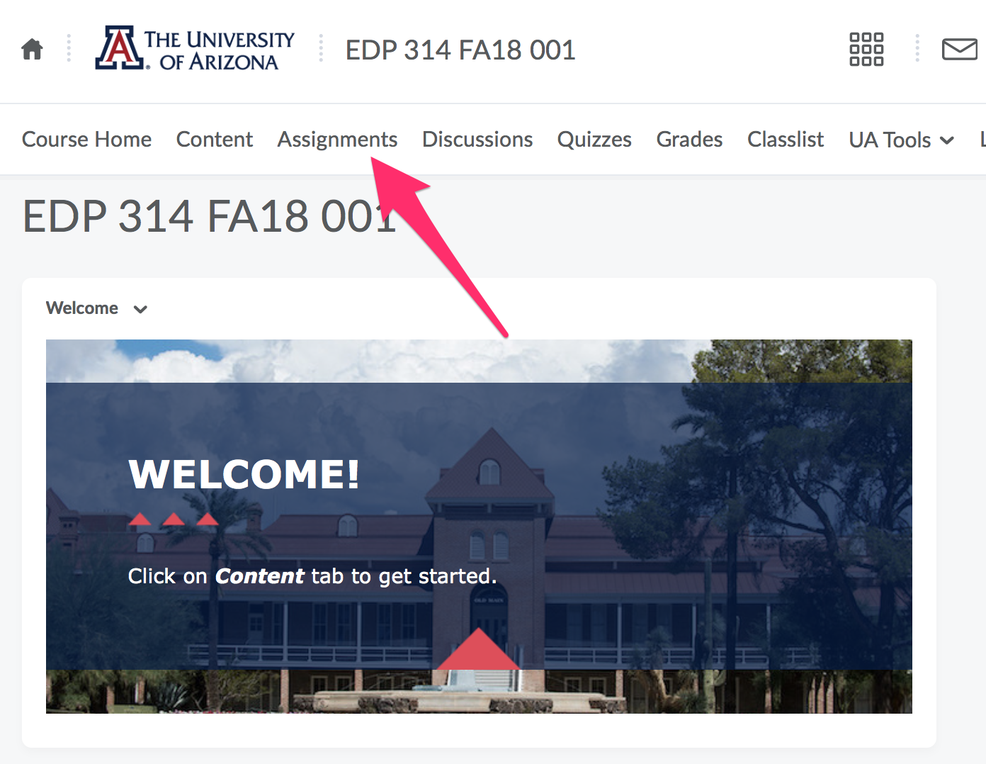

Slide 9
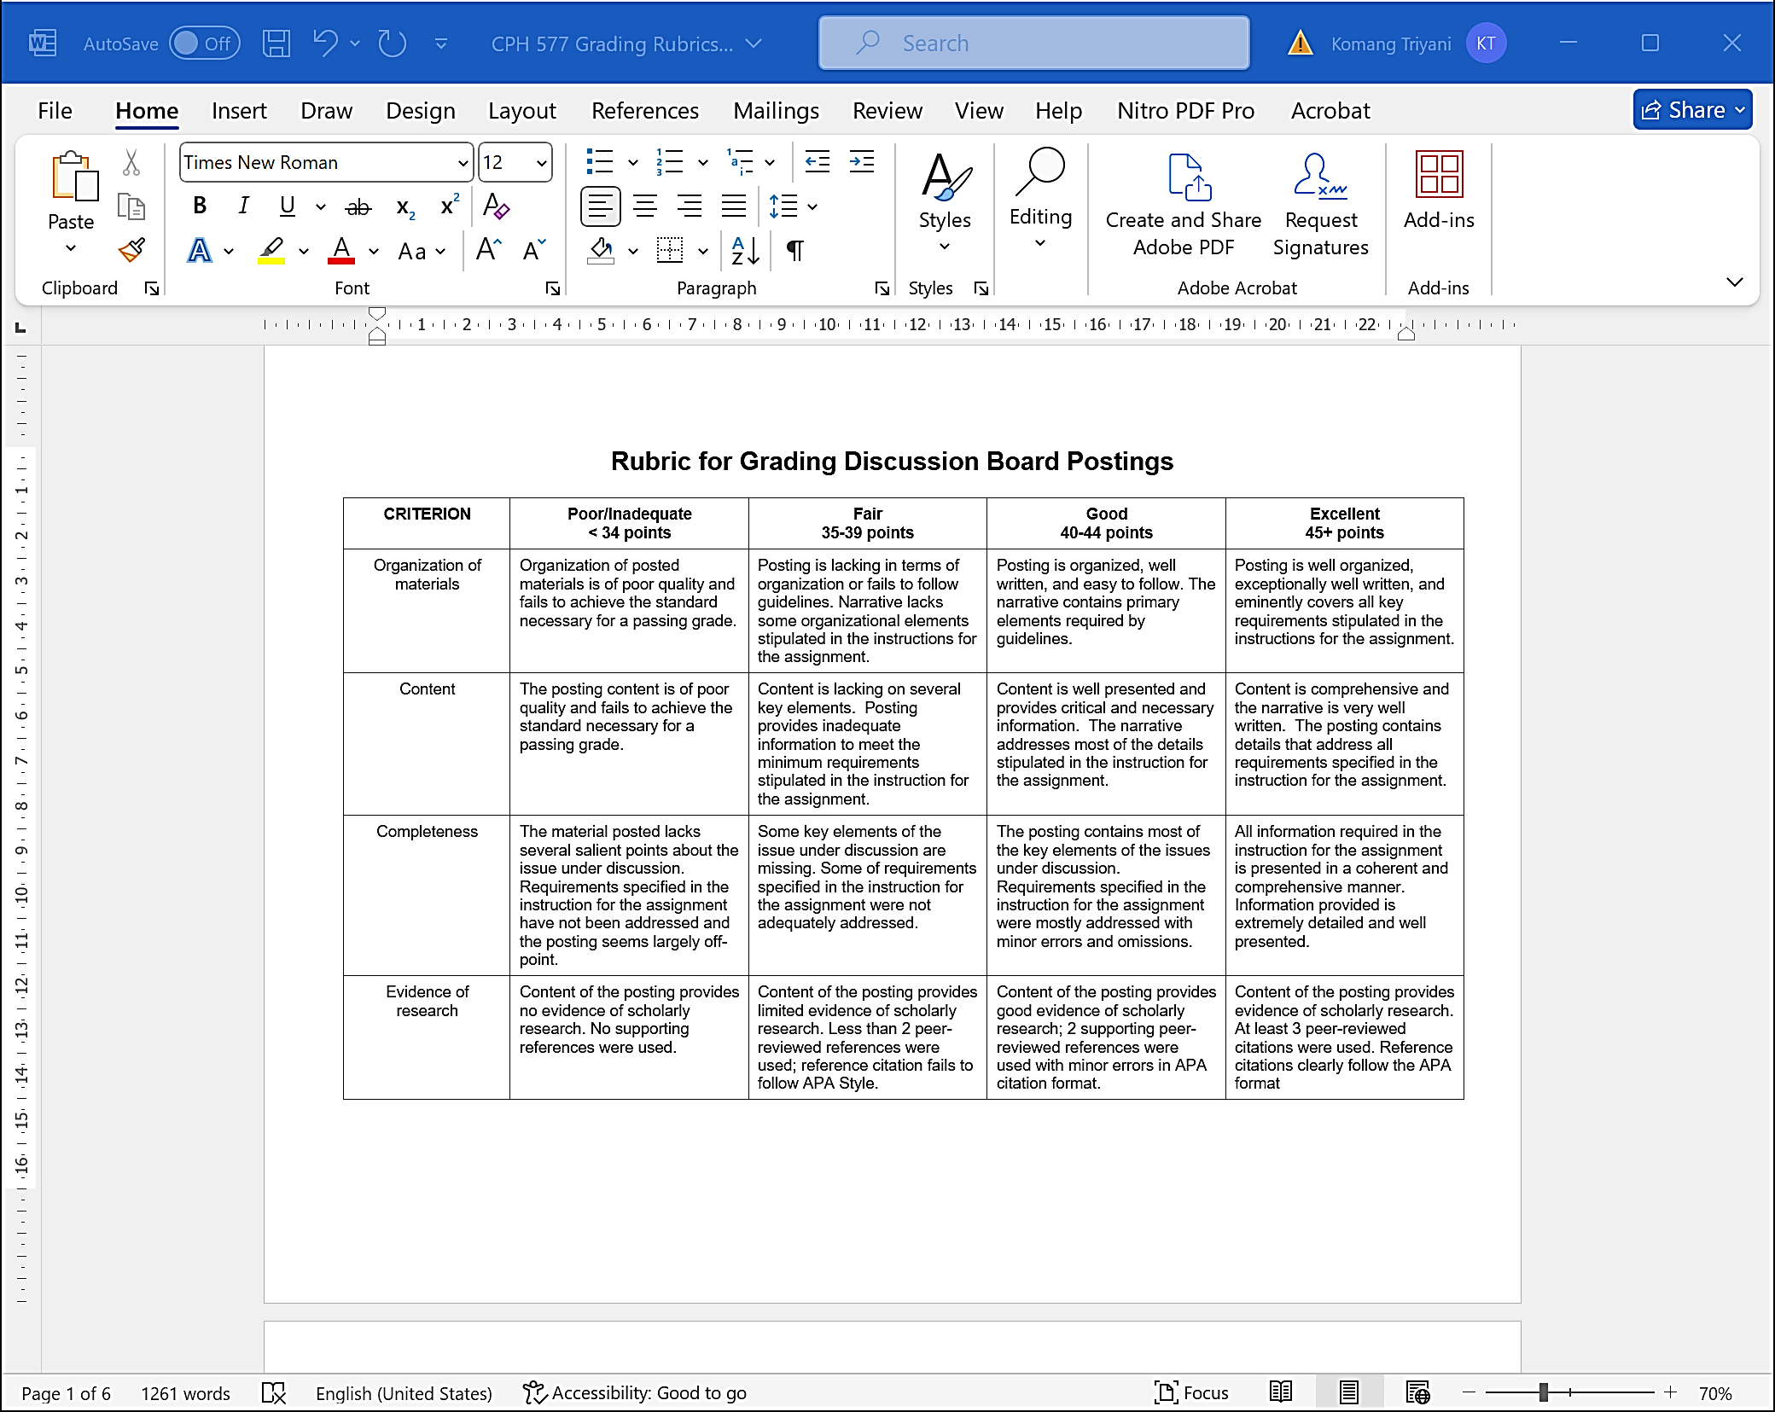

Slide 10
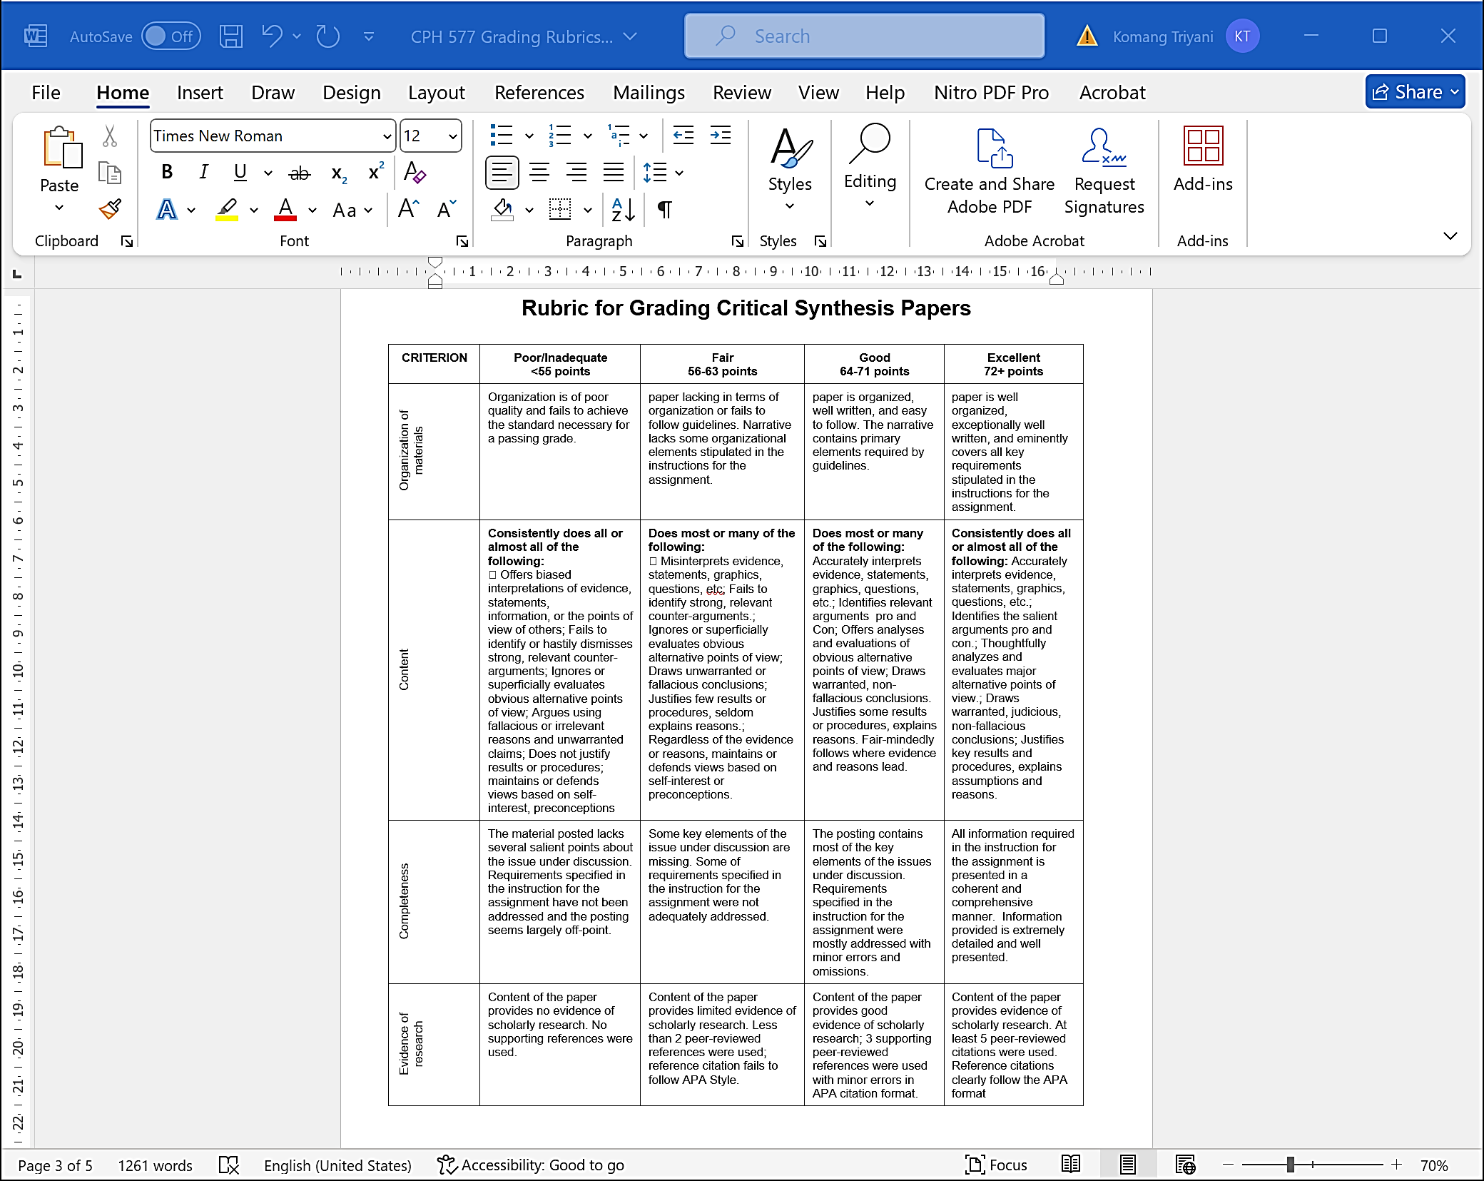

Slide 11
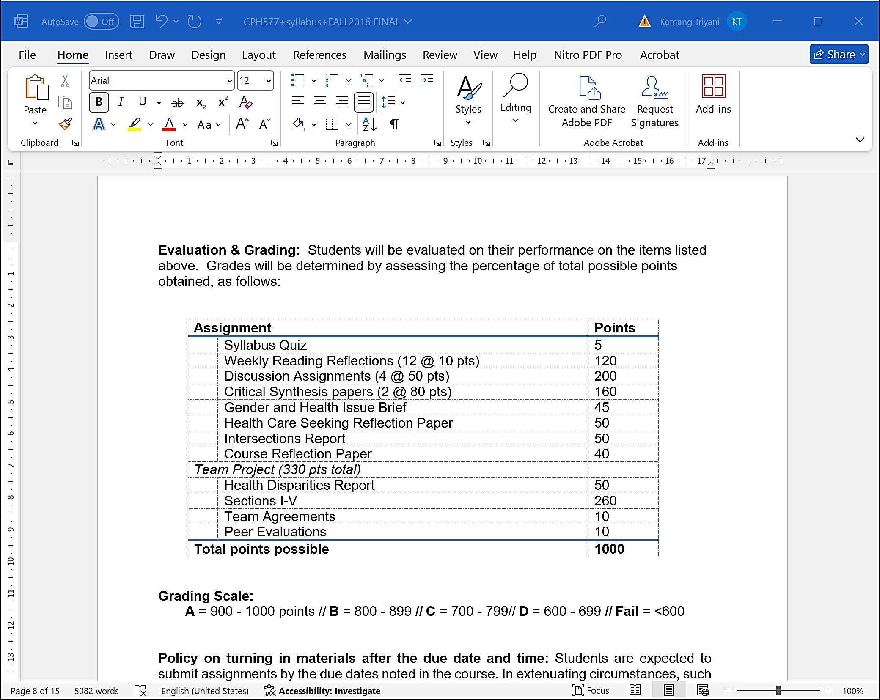

Slide 12
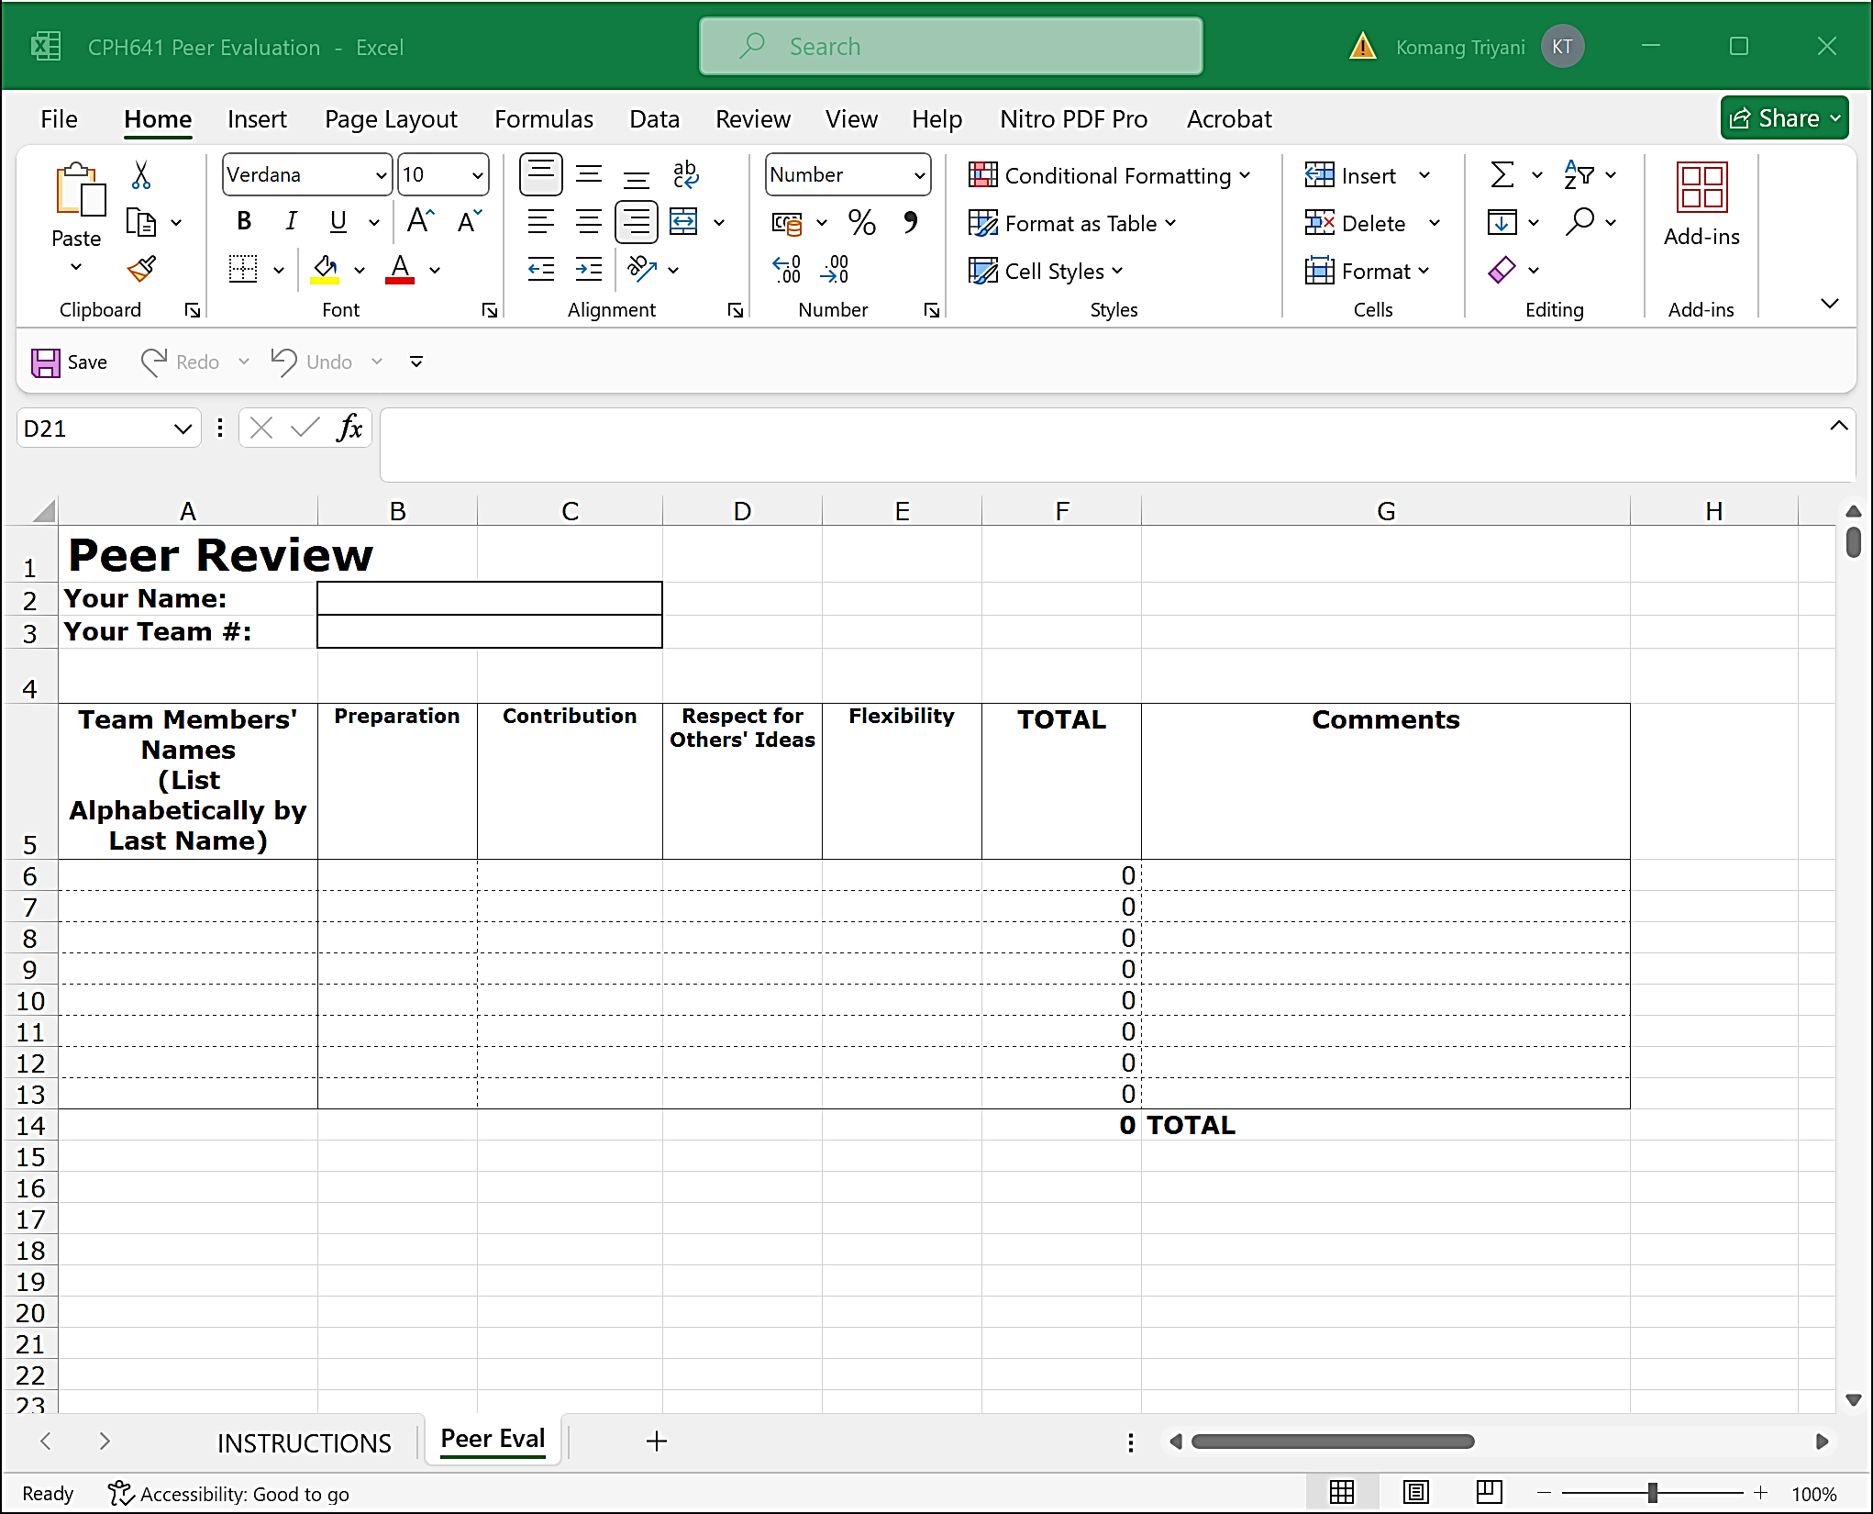

Slide 13
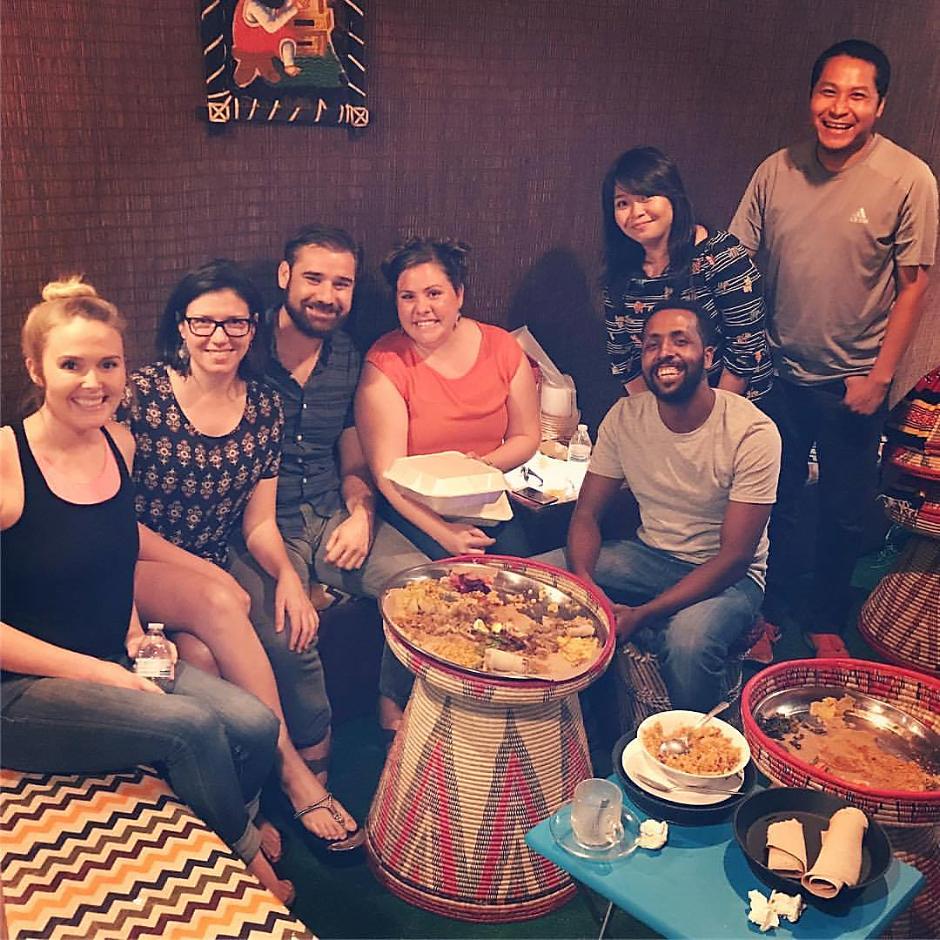
Networking and Collaboration
with Local Professionals
Networking Events
Attending workshops, conferences, or gatherings can provide opportunities to connect with local experts and organizations.
Internships and Placements
Securing internships or placements with local agencies or NGOs can lead to valuable hands-on experience and potential future partnerships.
Collaborative Projects
Collaborating with local professionals on research projects, community initiatives, or policy development can foster meaningful cross-cultural exchange and learning.

Slide 14
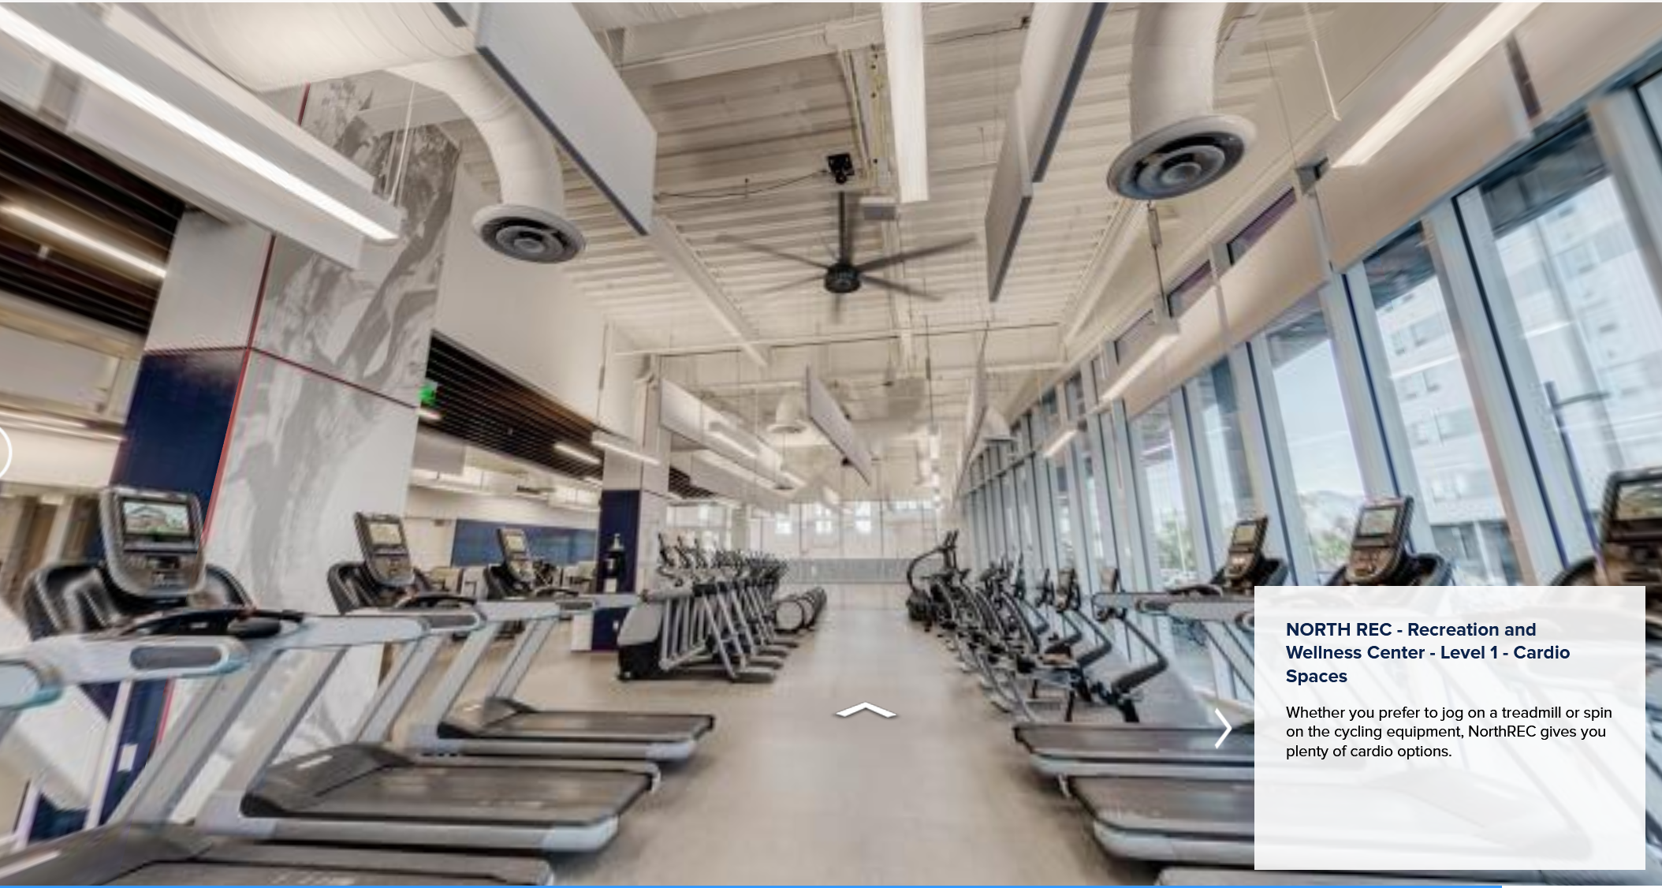
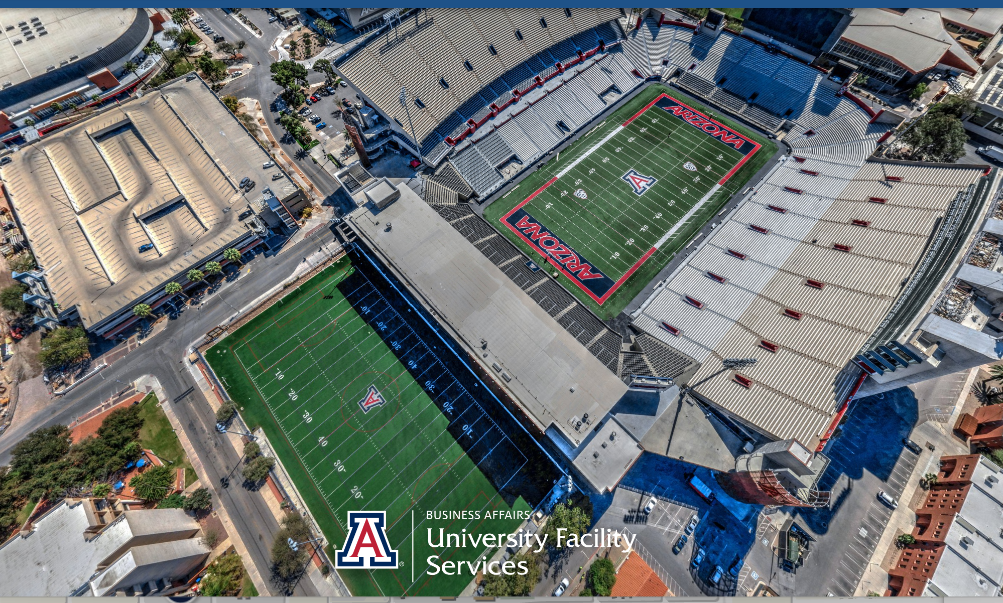
Challenges for International Students
Language Barriers
Cultural Adjustment
Homesickness

Slide 15
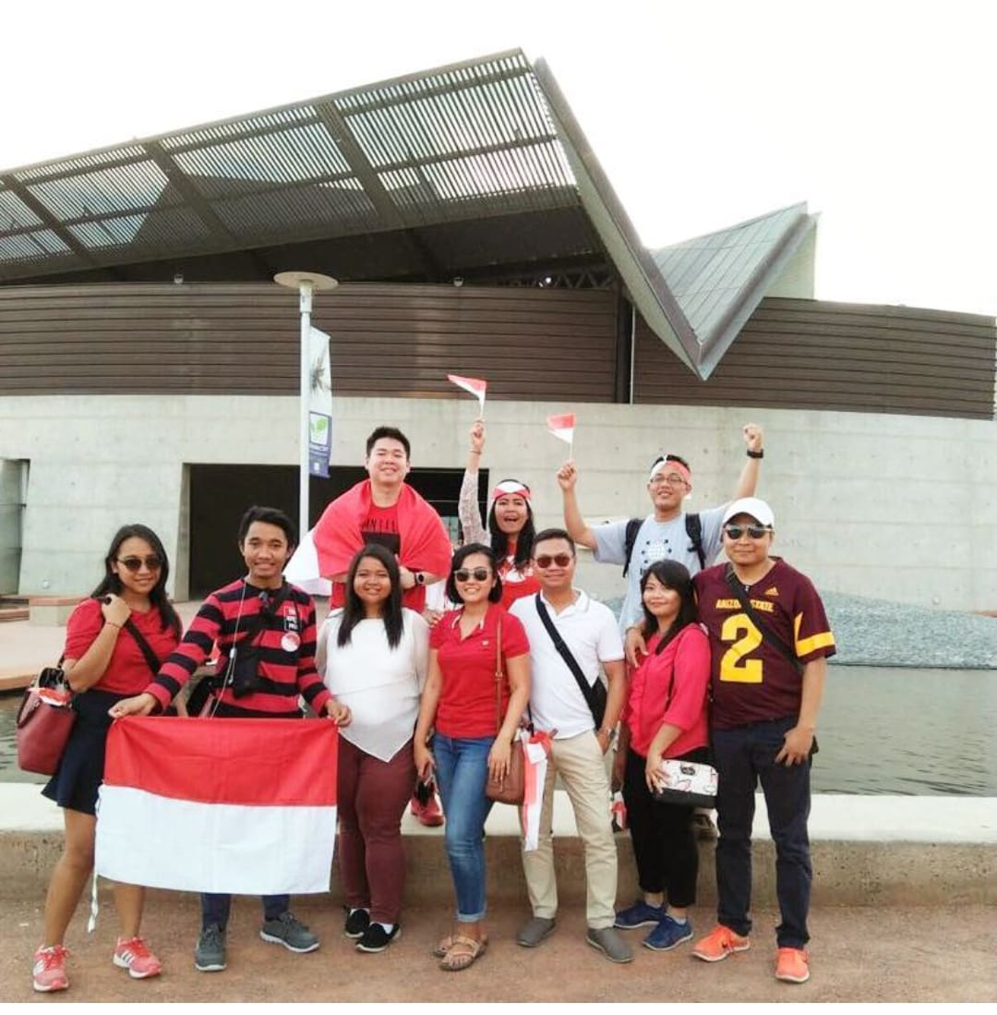
PERMIAS ARIZONA
Building an International Network
1
Make Local Connections
Actively engage with your university's student organizations and social events.
2
Connect with Fellow International Students
Befriend other international students and explore the host country together.
3
Maintain Relationships
Stay in touch with your new international contacts, fostering long-lasting connections.

Slide 16
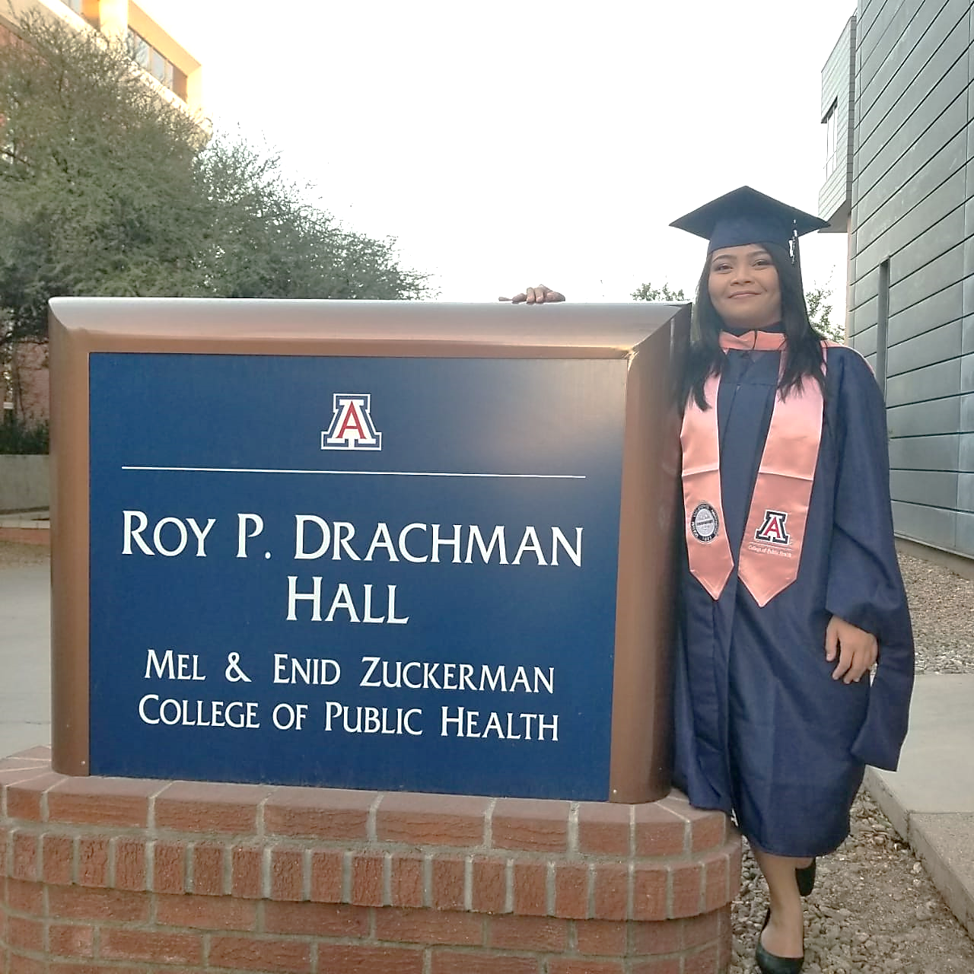
Lessons Learned from Studying Abroad
1
Global Perspective
The international experience and understanding of diverse public health systems can inform future career choices and help navigate the increasingly globalized world of public health.
2
Cross-cultural Communication
Developing strong cross-cultural communication skills can enhance one's ability to work effectively with diverse teams and stakeholders in the public health field.
3
Problem-solving Mindset
The adaptability and problem-solving skills gained through the study abroad experience can be valuable assets in navigating the dynamic and ever-changing landscape of public health.

Slide 17
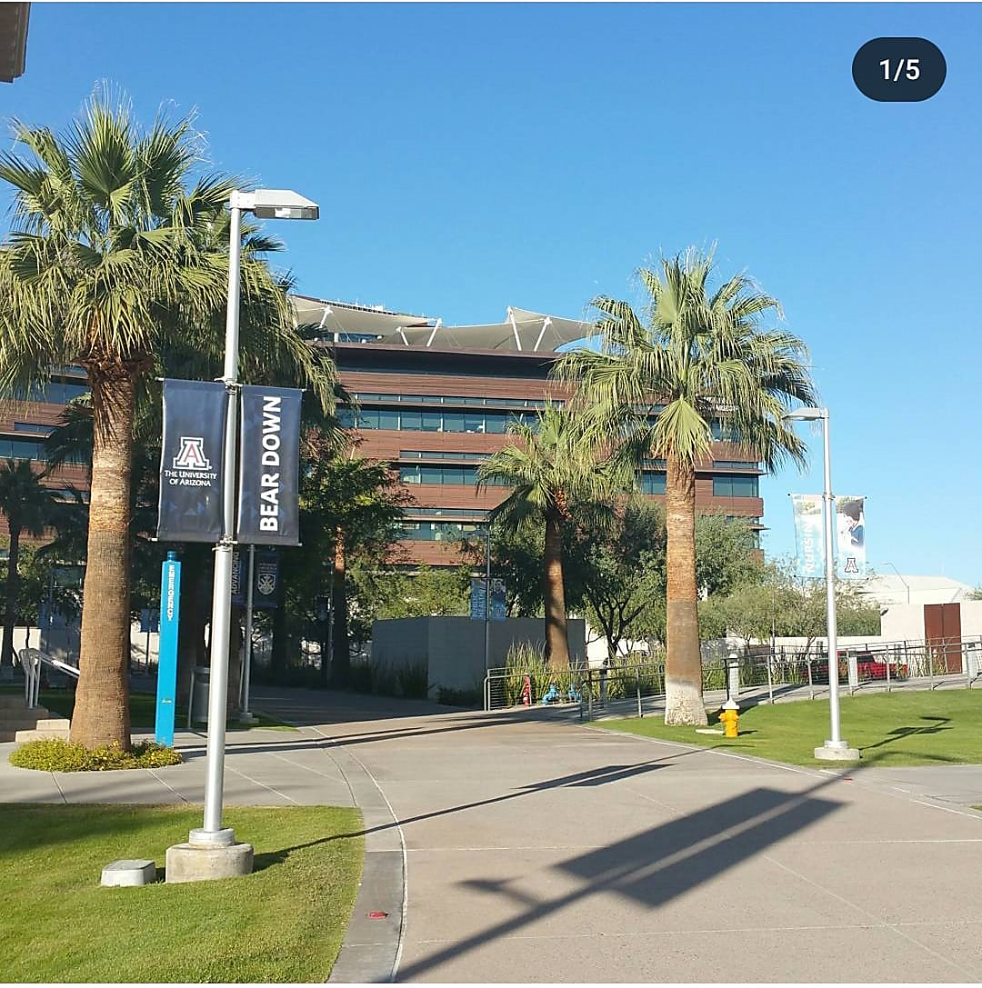
Reflections and Takeaways from the Study Abroad Journey
Personal Growth
Expanded Worldview
Studying abroad fosters personal development, such as increased independence, adaptability, and global mindset
The exposure to diverse cultures, healthcare systems, and public health approaches broadens understanding of the multifaceted nature of global health issues.
Lifelong Connections
Lasting Impact
The relationships and networks formed during the study abroad experience can lead to future collaborations, research opportunities, and career prospects.
The valuable lessons and transformative experiences from studying abroad can profoundly shape one's career trajectory and commitment to making a positive impact in the home country

Slide 18
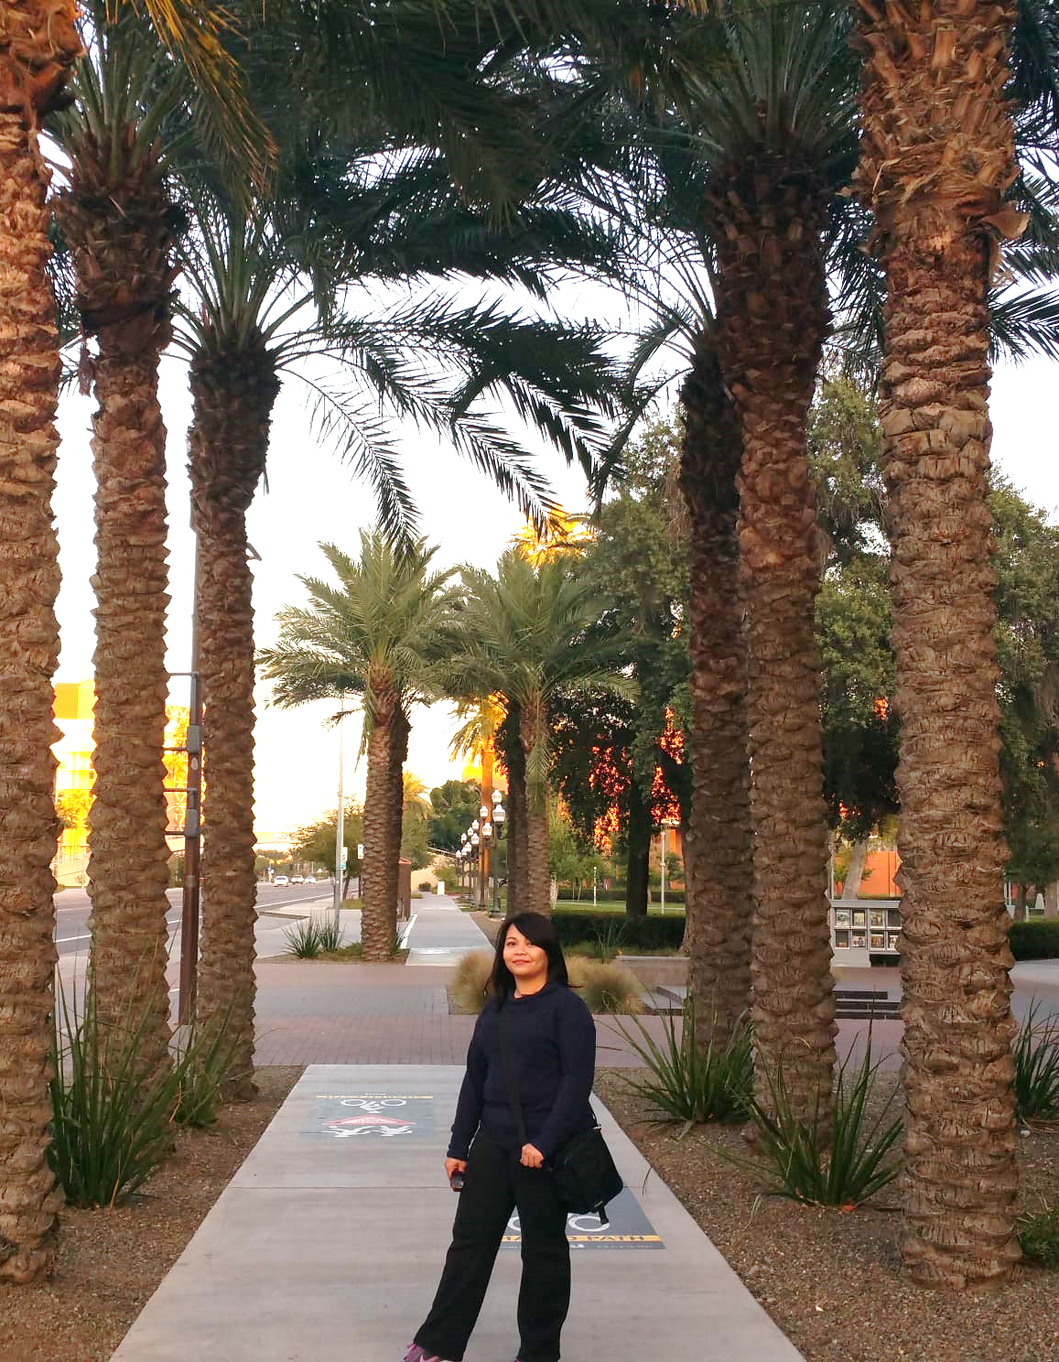
Thank you!

